Slide 1
DFROM – Detecting Fake Reviews using Opinion Mining.
Project group: 22
Ansari Faiz 14CO17
Khan Khalid 16CO54
Shaikh Azamali 17DCO75
Project Guide:
Prof. Mukhtar Ansari

Slide 2
Abstract.
Digital makting is booming, in today’s lifeline online business in mainly dependent on review and rating of perticular poduct.
Seller or product owner post fake reviews to increase their product’s ratings.
Our system is mainly focuses on movies reviews & rating.
We are going to use Sentiment Analysis(SA) to detect whether the posted review is genuine or not.

Slide 3
Literature Summary.
Features/Papers | Android Application | Text Classification | SVM Algorithm | operation on actual data | Detection Of movie reviews | Result Storage | Web Application
Paper 1 | NO | YES | YES | NO | NO | NO | YES
Paper 2 | NO | YES | NO | NO | NO | NO | YES
Paper 3 | NO | YES | YES | NO | YES | NO | YES
Our System | YES | YES | YES | YES | YES | YES | YES

Slide 4
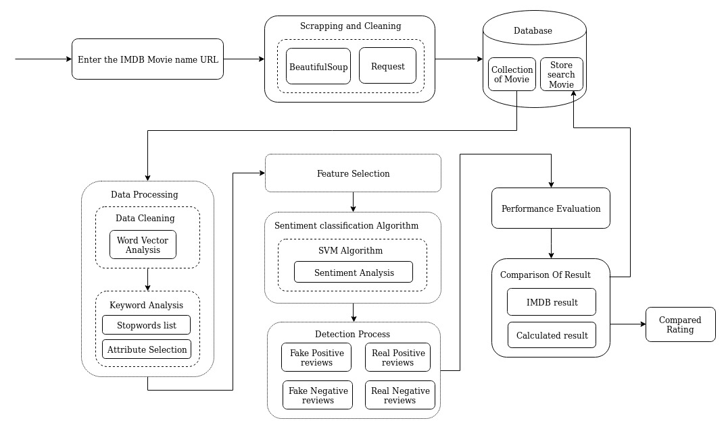
System Architechture.

Slide 5
Modular Explaination.
Dataset scrapping.
Datasets will be extracted from movies reviewing websites like IMDB by dbmovies API.
Datasets can be scrapped by using Beautifulsoup liberary(optional).
Data Processing.
Pre-processing of reviews.
Discarding stopwords as they don’t share much polarity.
Converting sentence into vectors, data is divided into tokens.
Detection Process.
Applying SVM algorithm on processed data.
0-Positive 1-Negative
Result Evaluation.
Display result to user and compare the resultant data to the originally retrieved data.

Slide 6
Reference.
https://www.researchgate.net/publication/320971538_An_empirical_study_on_detecting_fake_reviews_using_machine_learning_techniques
https://pdfs.semanticscholar.org/6005/58b138f32b211ffc71bf918c2005a9e4e0e5.pdf
https://medium.com/datadriveninvestor/twitter-sentiment-analysis-of-movie-reviews-using-machine-learning-techniques-23d4724e7b05
https://asso-aria.org/coria/2012/273.pdf

